Slide 1

AI Truck Parking Game
Project Engineering - Year 4
Vaclav Vincent Hornak - G00366783
Bachelor of Engineering (Honours) in Software and Electronic Engineering
Galway-Mayo Institute of Technology
2021/2022

Slide 2
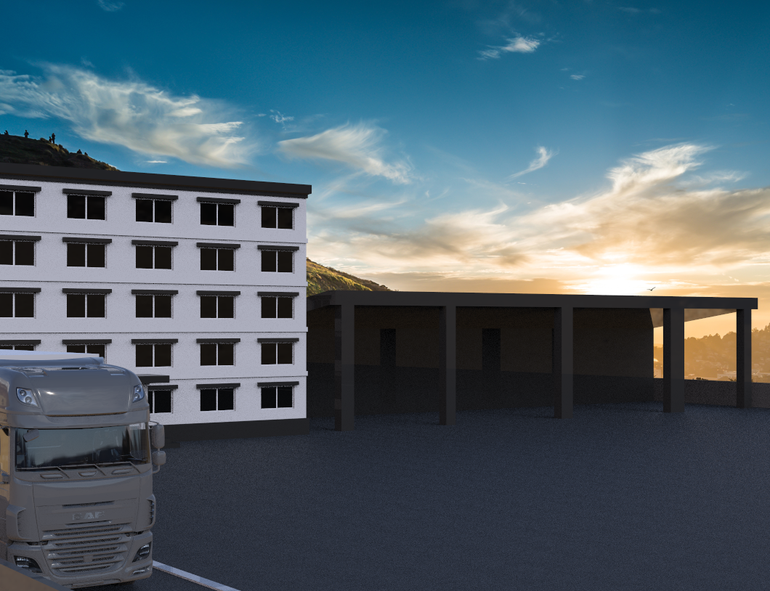
Introduction
For my final year project, I decided to look into developing a game which I have had interests in for years and within that game, try to teach AI to park a truck with a trailer.
The idea game from my hobby of truck simulation and the recent shortage of HGV drivers around Europe which effected the economy in a negative way.
I think this project can be developed and used to teach future drivers how to park with a large truck which is a skill people struggle with due to the sheer size of the vehicle.

Slide 3
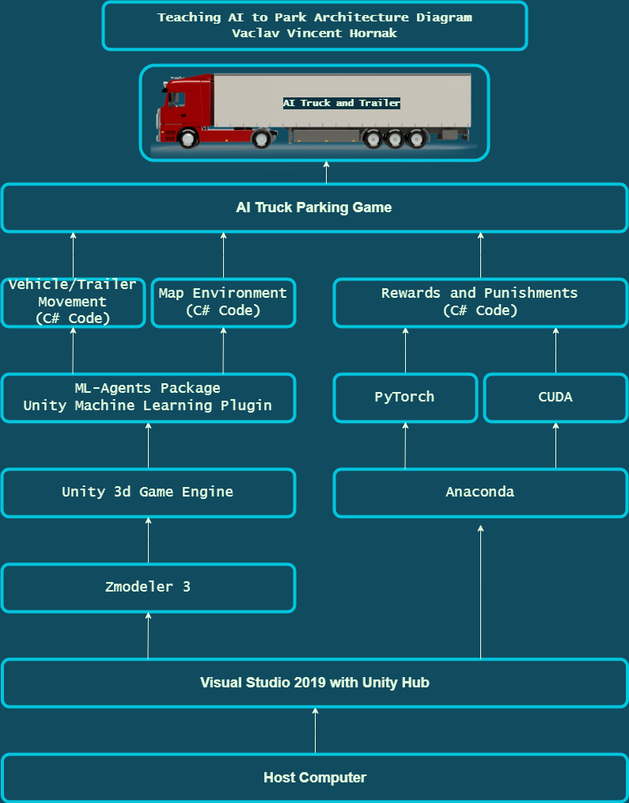
Architecture Diagram

Slide 4




Technologies
Unity is the game engine my parking game runs on.
C# is the main code used to create the scripts for the actions within the game.
Zmodeler 3 was used to create the 3D models used.
GitHub was used to host my code and allow for version control.

Slide 5
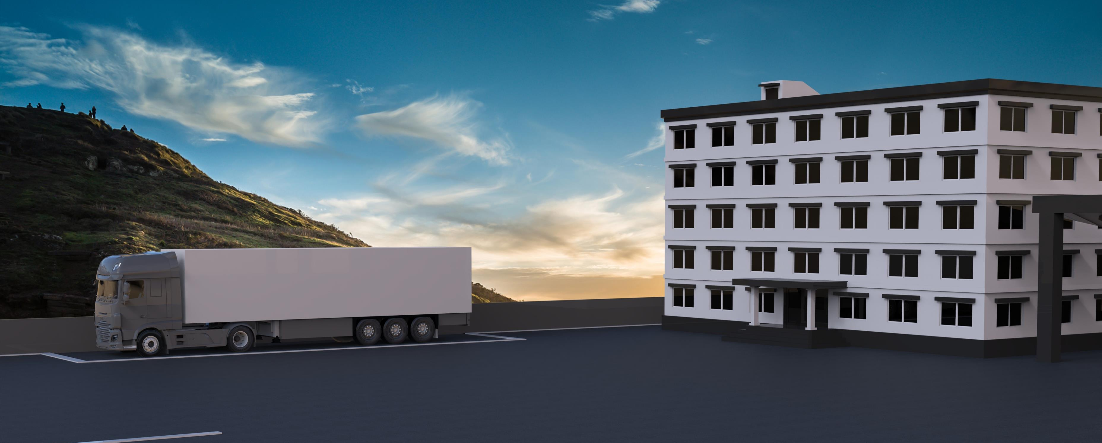
Conclusion
The game allows for a user to manually control a truck which is connected to a semi-trailer on a self built environment to drive to the required parking spot to complete the task at hand. The game development was very enjoyable and something that I will look towards as a career in the future.
Although I struggled to integrate the AI into my project, I learned a lot from my extensive research and will look to add it to my project in my own time and get a better understanding for this type of machine learning.

